Slide 1


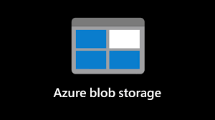



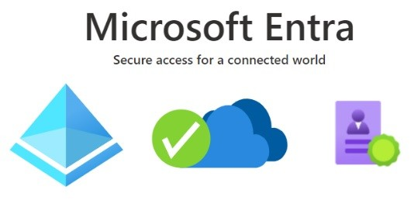








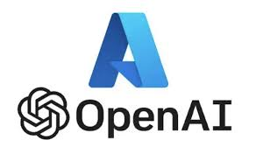





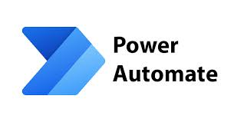






EduPulse AI - Solution Architecture & Flow
Architecture & Flow – Incident Management
Tools Used:
MS Power Platform
MS Power BI
Power App
MS Power Automate
Co Pilot Studio Agent
MS Email
MS SharePoint
MS List
Azure Ai Foundry
RAG
Ai Services
Vector DB-Azure Ai Search
I
RAG

